Slide 1
React JS Basics Level 1
02-03-2021

Slide 2
Agenda / Content Overview
Introduction, Installation , Features
Props, State and Component Life Cycle
Component development using JSX
Hooks (useState)
Working with Bootstrap and Jquery
Handling Events,

Slide 3
Agenda / Content Overview
07.
Keys , List and Conditional Rendering
09.
Working with Forms, Controlled Vs. Uncontrolled Component
10.
Performing REST API calls​
​

Slide 4
Introduction, Installation , Features

Slide 5
Introduction
What is React?
Developed by Face book in 2011
Open Sourced in 2015 and has a large community
"A JavaScript Library for building User Interfaces"
Declarative, efficient, and flexible JavaScript library for building user interfaces
compose complex UIs from small and isolated pieces of code called “components”.
React implements one-way data flow which makes it easy
Uses Flux is a pattern that helps keeping your data unidirectional.
solve one problem: building large applications with data that changes over time
Extremely fast, because it uses a virtual DOM, and syncs only the changed parts with the underlying page

Slide 6
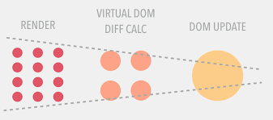
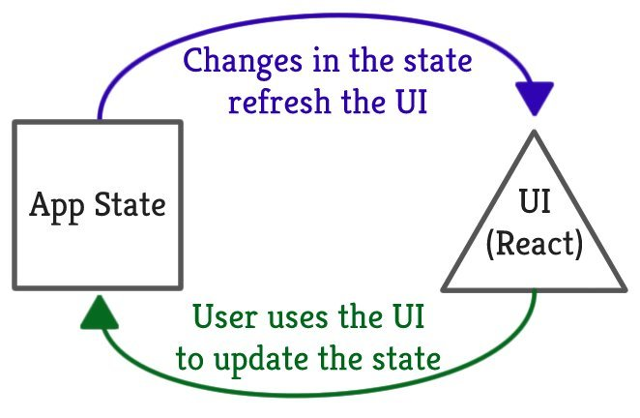
Introduction
Working of Virtual DOM
step 1: Whenever anything may have changed, the entire UI will be re-rendered in a Virtual DOM representation.
step 2:The difference between the previous Virtual DOM representation and the new one will be calculated.
step 3:The real DOM will be updated with what has actually changed. This is very much like applying a patch.

Slide 7
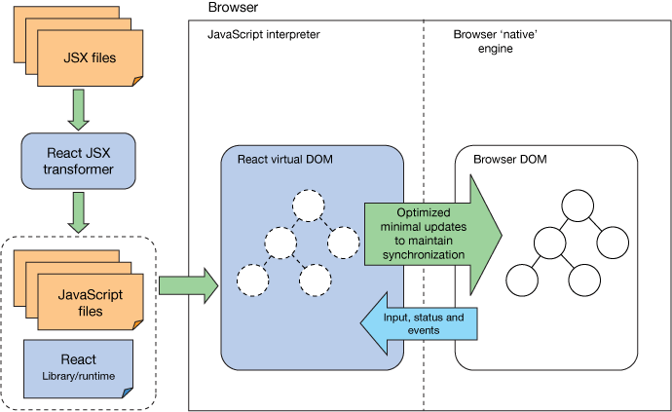
Introduction
What is React JS?
a front-end framework used by Facebook internally for managing user interface
main function is to bind HTML elements to data and once this data changes, updating the interface so that you don't have to bind this data manually
It is only the view layer and is all about modular, composable components
solve one problem: building large applications with data that changes over time
Extremely fast, because it uses a virtual DOM, and syncs only the changed parts with the underlying page

Slide 8

Features

Slide 9
Features
Overview
Advantages
Uses virtual DOM which is a JavaScript object. Improves apps performance, since JavaScript virtual DOM is faster than the regular DOM.
Can be used on client and server side(With node js) also on the client side
Component and data patterns improve readability, which helps to maintain larger
Limitations
Covers only the view layer of the app, hence you still need to choose other technologies to get a complete tooling set for development.
Uses inline templating and JSX, which might seem awkward to some developers
React is a view layer library, not a framework like Backbone, Angular etc.
You can't use React to build a fully-functional web app

Slide 10
Installation
Step 1 : npm install -g create-react-app
Npx create-react-app
Step 2: create-react-app reactproject
NOTE: We can combine the above two steps in a single command using npx. The npx is a package runner tool which comes with npm 5.2 and above version.
npx create-react-app reactproject
Start the server using the below command
npm start
if we want to make the project for the production mode, type the following command. This command will generate the production build, which is best optimized.
$ npm build

Slide 11
Installation
NPM - Package manager
NPX - Package runner
npm create-react-app my-app executes the local create-react-app package from your machine, so you first have to install it globally on your system with npm install -g create-react-app.
If you run npx create-react-app my-app and don’t have create-react-app globally on your system, it will get downloaded and not installed globally. This is great if you don’t want to pollute your system with global packages that you only run once every two months.
Installing packages
npm install –save react-bootstrap

Slide 12
Component development using JSX

Slide 13
Component development using JSX
What is JSX?
JSX is an inline markup that looks like HTML and gets transformed to JavaScript
JSX expression starts with an HTML-like open tag, and ends with the corresponding closing tag. JSX tags support the XML self close syntax so you can optionally leave the closing tag off.
It is a preprocessor step that adds XML syntax to JavaScript
React can be used without JSX but JSX makes React a lot more elegant(it is a concise and familiar syntax for defining tree structures with attributes)
It’s actually a declarative syntax that’s used to express the virtual DOM.
JSX gets interpreted and converted to virtual DOM, which gets diffed against the real DOM.
Rather than rewrite the whole DOM tree, only the differences get applied. That makes React renders fast.

Slide 14
JSX Overview
What is JSX?
Really just JavaScript with HTML in the render methods
Use className instead of class
Components are written in JSX
Helps in creating a virtual DOM by returning HTML
It is faster because it performs the optimization while compiling code into javascript
It is typesafe most of the errors can be caught during compilation
Bindings:
Mustache syntax {}
Bind to props
Note : JSX is optional

Slide 15
React vs Angular
Technology | AngularJS | React
Developer | Google | Facebook
Technology type | Full-fledged MVC framework written in JavaScript | JavaScript library (View in MVC; requires Flux to implement architecture)
Concept | Brings JavaScript into HTML Works with the real DOM Client-side rendering | Brings HTML into JavaScript Works with the virtual DOM Server-side rendering
Data binding | Two-way data binding | One-way data binding
Dependencies | Manages dependencies automatically | Requires additional tools to manage dependencies
Language | JavaScript + HTML | JavaScript + JSX
Last version | AngularJS 1.6.0 RC2 | React 16
Suits best | Best for SPAs that update single view at a time | Best for SPAs that update many views at a time

Slide 16
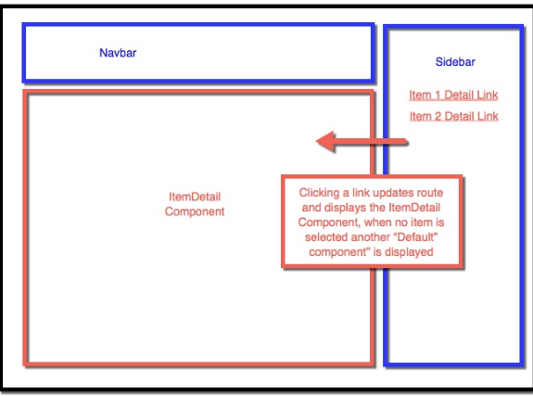
Components
Components
React is all about modular, composable components
Components are just like functions(Simple functions that take in “props” and “state”)
React encourages reusable components which can be integrated into your project
Example: A login system can be broken down into one root component with several child components.

Slide 17
Types of components
There are two types of Components
1. Functional
--do not maintain state
--static data
2. class based
--data changes over time
--dynamic data
--maintain the state data

Slide 18
Adding Bootstrap to React Application

Slide 19
Adding Bootstrap to React Application
Refer to the online documentation
https://react-bootstrap.github.io/getting-started/introduction
Step 1: From the command prompt move to your project folder and install the bootstrap package
Adding bootstrap
D:\nodeprojects\reactlevel1>npm install react-bootstrap bootstrap
Step 2:Adding stylesheet in index.html before </head>
<link rel="stylesheet" href="https://maxcdn.bootstrapcdn.com/bootstrap/4.4.1/css/bootstrap.min.css" integrity="sha384-Vkoo8x4CGsO3+Hhxv8T/Q5PaXtkKtu6ug5TOeNV6gBiFeWPGFN9MuhOf23Q9Ifjh" crossorigin="anonymous" />
Step 3: Now lets try applying style on a button
In App.js import the required Class eg Button
import { Button } from 'react-bootstrap';
Add some style on the Button in the div element using the variant
<Button variant="primary">Hello World Primary</Button>
<Button variant="success">Hello World Success</Button>
<Button variant="danger">Hello World Danger</Button>

Slide 20
Props, State and Component Life Cycle

Slide 21
Props
React allows us to pass information to a Component using something called props (stands for properties).
Props are basically kind of global variable or object.
We can pass props to any component as we declare attributes for any HTML tag. Have a look at the below code snippet:
<DemoComponent sampleProp = "HelloProp" />
We can access any props inside from the component’s class to which the props is passed. The props can be accessed as shown below:
this.props.propName;
The ‘this.props’ is a kind of global object which stores all of a components props. The propName, that is the names of props are keys of this object.
We can use the propType for validating any data we are receiving from props.
Demo

Slide 22
props
Component Properties
Component properties are known as props
Props are the "arguments" to your components
React encourages reusable components which can be integrated into your project
attributes are available in our component as this.props and can be used in our render method to render dynamic data and any nested elements as this.props.children

Slide 23
state
React components has a built-in state object.
The state object is where you store property values that belongs to the component.
When the state object changes, the component re-renders.
The state object is initialized in the constructor
class Car extends React.Component { constructor(props) {
super(props);
this.state = {brand: "Ford"}; }
render() { return ( <div> <h1>My Car</h1> </div> );
}
}

Slide 24
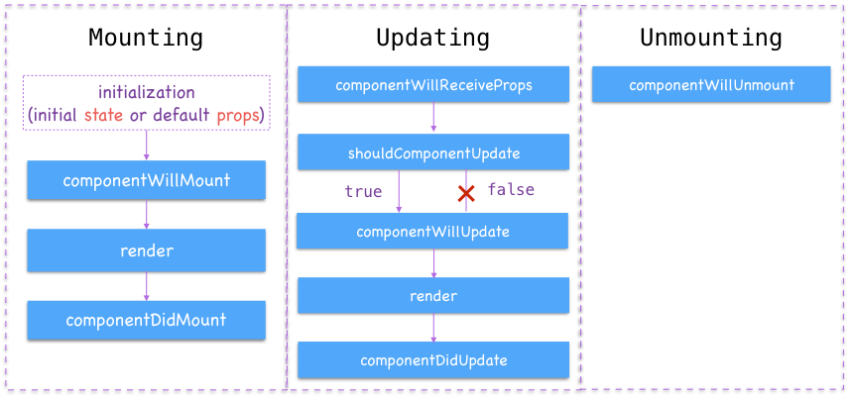
Component life cycle
Component Lifecycle
The render method is the only required spec for creating a component, but there are several lifecycle methods & specs
They notify us of important milestones in our component's life, and we can use these notifications to simply pay attention or change what our component is about to do
Can be categorized into 4 phases:
Initialization
Mounting
Updation
Unmounting

Slide 25
Components Lifecycle
Components Lifecycle
Initialization
The initialization phase is where we define defaults and initial values for this.props and this.state
getDefaultProps():
method is called once and cached before any instance of the component are created.
method returns an object which properties values will be set on this.props if that prop is not specified by the parent component.
getInitialState():
method is also invoked once, right before the mounting phase.
return value of this method will be used as initial value of this.state and should be an object.

Slide 26
Components Lifecycle
Components Lifecycle
Mounting
componentWillMount()
invoked once and immediately before the initial rendering occurs, hence before React inserts the component into the DOM
Note: calling this.setState() within this method will not trigger a re-render
componentDidMount()
last step in the Birth/Mount life cycle phase
method is called once all our children Elements and our Component instances are mounted onto the DOM
is executed after the first render only on the client side. This is where AJAX requests and DOM or state updates should occur.

Slide 27
Component life cycle
Components Lifecycle
Updation
component updating phase is when an user trigger updations like state value change trough a function executed on user events like onClick, onChange etc which triggers a set of component state/props change usually and the component render occurs updating the DOM accordingly
componentWillReceiveProps()
method is called when props are passed to the Component instance.
Here we could extract the new props and allows us to check and see if new props are coming in and we can make choices based on the data
Method can be skipped if the Update is triggered by just a state change.

Slide 28
Components Lifecycle
Components Lifecycle
Updating
shouldComponentUpdate()
allows your Component to exit the Update life cycle if there is no reason to apply a new render.
Whenever a component’s state changes, React re-renders the component and all its children. Often times, the component and its children barely change yet we need to render everything causing an inefficient code rendering.
method checks the current props and state, compares it to the next props and state and then returns true if they are different, or false if they are the same. Based on the Boolean value, rendering can be avoided when it isn’t needed

Slide 29
Components Lifecycle
Components Lifecycle
Updating
componentWillUpdate()
is called just before rendering.
method is passed in two arguments: nextProps and nextState
method is called every time a re-render is required, such as when this.setState() is called. Unlike componentWillMount() we get access to the next props and state.
this method is called before render(). Because we have not rendered yet, our Component’s access to the Native UI (DOM, etc.) will reflect the old rendered UI. Is executed before rendering, on both the server and the client side.
componentDidUpdate()
Useful when an operation needs to happen after the DOM is updated and the update queue is emptied
most common use case would be, updating the DOM in response to prop or state changes.

Slide 30
Components Lifecycle
Components Lifecycle
Unmounting
react component undergoes the Unmounting Phase, while the component is deleted/removed from the DOM, and any last updations and functions to be executed while the component is being removed shall be done in the Unmounting phase
componentWillUnmount()
component is almost done and is going to be removed/deleted. Maybe forever or conditionally like show and remove.
Here you can cancel any outgoing network requests, or remove all event listeners associated with the component.
Basically, clean up anything to do that solely involves the component.

Slide 31
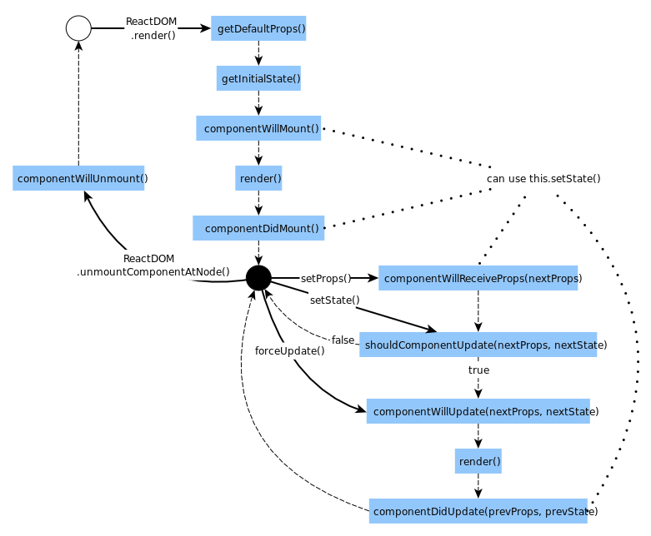
Complete flow

Slide 32
Handling Events

Slide 33
Events
Steps in Event Handling
Step 1Bind the event
this.increase = this.increase.bind(this);
Step 2: Implement the event handler where we react to the event
Event Handler:
increase(e) {
this.setState({
count: this.state.count + 1
});
}
Step 3:: Listen for the event on the Control.
<button onClick={this.increase} style={buttonStyle}>+</button>

Slide 34
Hooks (useState)

Slide 35
Hooks
Hooks are the new feature introduced in the React 16.8 version.
It allows you to use state and other React features without writing a class.
Hooks are the functions which "hook into" React state and lifecycle features from function components
It does not work inside classes.
Hooks are backward-compatible, which means it does not contain any breaking changes. Also, it does not replace your knowledge of React concepts.
React Hooks installation
$ npm install react@16.8.0-alpha.1 --save
$ npm install react-dom@16.8.0-alpha.1 --save
Hook uses useState() functional component for setting and retrieving state.
Demo

Slide 36
07.
Keys , List and Conditional Rendering

Slide 37
Working with keys
React keys are useful when working with dynamically created components
Also used when when your lists are altered by the users.
Setting the key value will keep your components uniquely identified after the change.
Code snippet:
render() {
return (
<div>
<div>
{this.state.data.map((dynamicComponent, i) => <Content
key = {i} componentData = {dynamicComponent}/>)}
</div>
</div>
);
}

Slide 38
Conditional Rendering
In React, you can create distinct components that encapsulate behavior you need. Then, you can render only some of them, depending on the state of your application.
Conditional rendering in React works the same way conditions work in JavaScript.
There are different methods to implement Conditional rendering
Using if..else
Using element variable
Using switch statement
Ternary operators
Using Enhanced JSX
Demo

Slide 39
08.
Forms, Controlled Vs. Uncontrolled Component

Slide 40
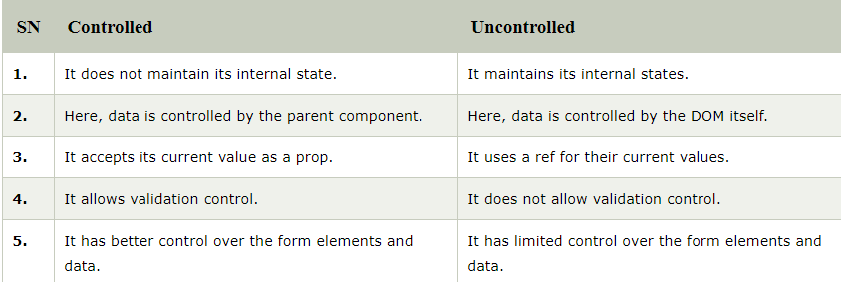
Forms
In HTML form elements such as <input>, <textarea>, and <select> typically maintain their own state and update it based on user input.
In React, mutable state is typically kept in the state property of components, and only updated with setState()
An input form element whose value is controlled by React in this way is called a “controlled component”.
Demo 1: Handling input Text in a Form
Demo 2: Handling a select control in the form

Slide 41
Controlled Vs. Uncontrolled Component
A controlled component is bound to a value, and its changes will be handled in code by using event-based callbacks.
It is similar to the traditional HTML form inputs.

Slide 42
09.
Performing REST API Call

Slide 43
REST call
Axios is among the most popular promise based HTTP clients for both browsers and Node.js.
Npm install axios
Get method is used to perform the get request.
axios.get(`https://jsonplaceholder.typicode.com/users`)
In Axios, you can create POST requests using the .post() method and passing the data as a second parameter
axios.post(url[, data[, config]])
.delete() method is used to perform a delete request.
axios.delete(url[, config])
Demo

Slide 45
Thank you

